Slide 1
What is Data Science?

Slide 2
What is Data Science?
Descriptive

Slide 3
What is Data Science?
Descriptive
Explorative

Slide 4
What is Data Science?
Descriptive
Explorative
Predictive

Slide 5
What is Data Science?
Descriptive
Explorative
Predictive
Prescriptive

Slide 6
Python Review

Slide 7
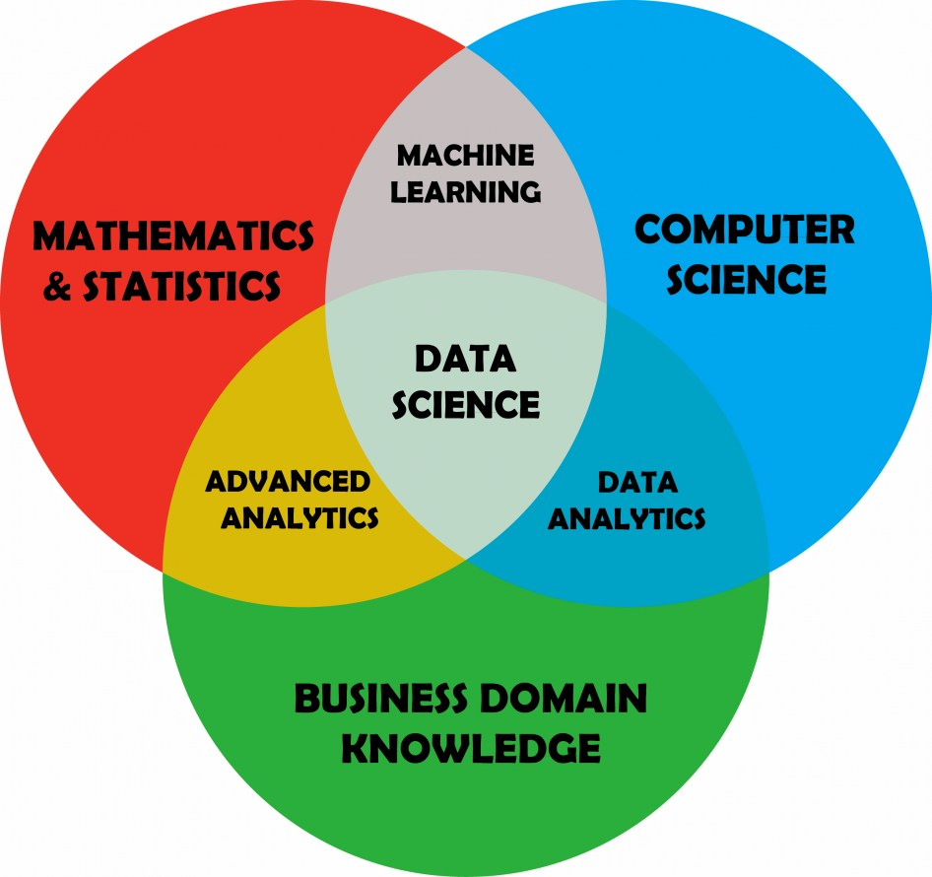
Data Science

Slide 8
Statistics

Slide 9
Statistics
Standard Deviation

Slide 10
Variance

Slide 11
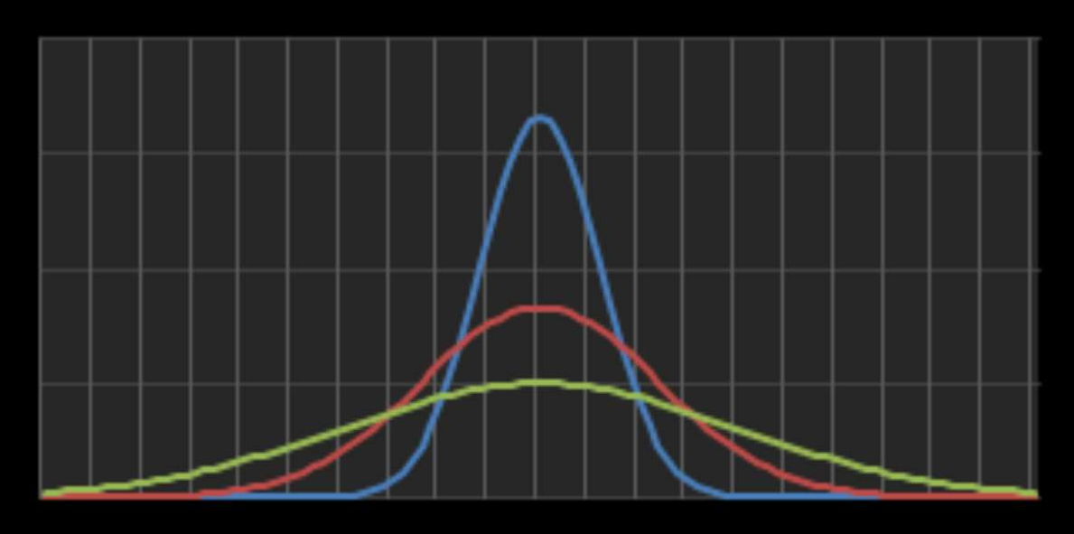

Slide 12








Slide 15
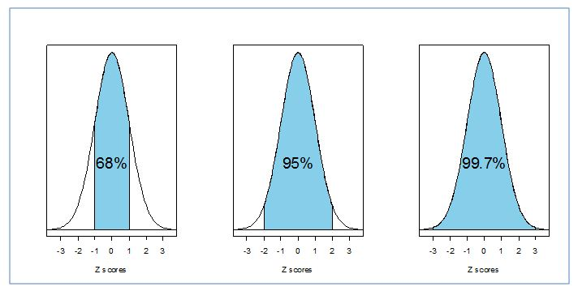
Empirical Rule

Slide 16
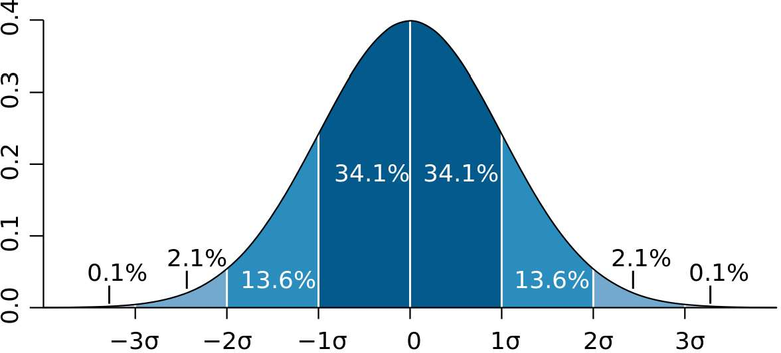

Slide 17
Measure | Qty
GPA | 3.75
TOEFL | 112
GRE | 301

Slide 18
Measure | Qty
GPA | 3.75
TOEFL | 112
GRE | 301
3.75
112
301
0

Slide 19
Measure | Qty | Standardized (z-score)
GPA | 3.75 | 1.18
TOEFL | 112 | 1.53
GRE | 301 | -.14

Slide 20




Measure | Qty | Standardized (z-score)
GPA | 3.75 | 1.18
TOEFL | 112 | 1.53
GRE | 301 | -.14
$$−2σ$$
-$1σ$
0
$$1σ$$
$$2σ$$

Slide 21
Measure | Qty | Standardized (z-score)
GPA | 3.75 | 1.18
TOEFL | 112 | 1.53
GRE | 301 | -.14
301
$$−2σ$$
-$1σ$
0
$$1σ$$
$$2σ$$
-.14

Slide 22
Measure | Qty | Standardized (z-score)
GPA | 3.75 | 1.18
TOEFL | 112 | 1.53
GRE | 301 | -.14
301
3.75
$$−2σ$$
-$1σ$
0
$$1σ$$
$$2σ$$
-.14
1.18

Slide 23
Measure | Qty | Standardized (z-score)
GPA | 3.75 | 1.18
TOEFL | 112 | 1.53
GRE | 301 | -.14
301
3.75
112
$$−2σ$$
-$1σ$
0
$$1σ$$
$$2σ$$
-.14
1.18
1.53

Slide 24
The Data Science Process

Slide 25
The Data Science Process
Identify the question

Slide 26
The Data Science Process
Identify the question
Get the data

Slide 27
The Data Science Process
Identify the question
Get the data
Clean the data

Slide 28
The Data Science Process
Identify the question
Get the data
Clean the data
Explore the data

Slide 29
The Data Science Process
Identify the question
Get the data
Clean the data
Explore the data
Model the data

Slide 30
The Data Science Process
Identify the question
Get the data
Clean the data
Explore the data
Model the data
Communicate the results

Slide 31
The Data Science Process
Identify the question
Get the data
Clean the data
Explore the data
Model the data
Communicate the results

Slide 32
Identify the question

Slide 33
Identify the question
Answerable
Actionable
Narrow
Specific

Slide 34
Get the data

Slide 35
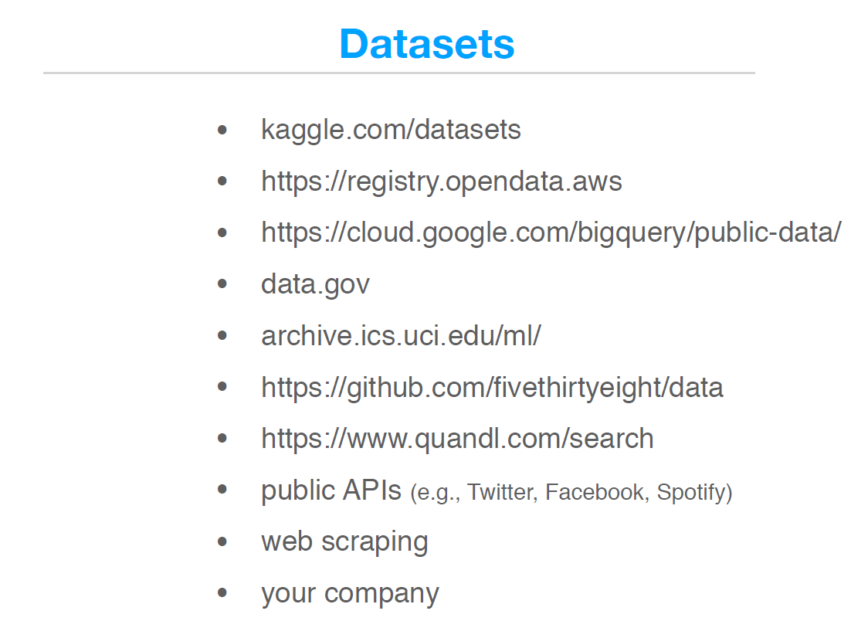
Data Sources

Slide 36
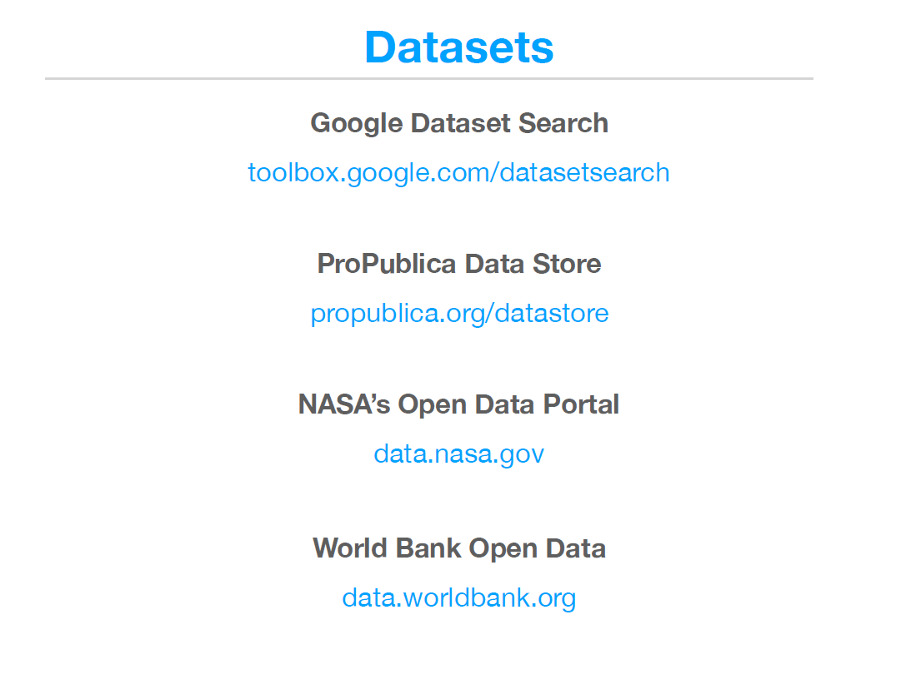
Data Sources

Slide 37
The Data Science Process
Identify the question
Get the data
Clean the data
Explore the data
Model the data
Communicate the results

Slide 38
The Data Science Process
Identify the question
Get the data
Clean the data
Explore the data
Model the data
Communicate the results

Slide 39
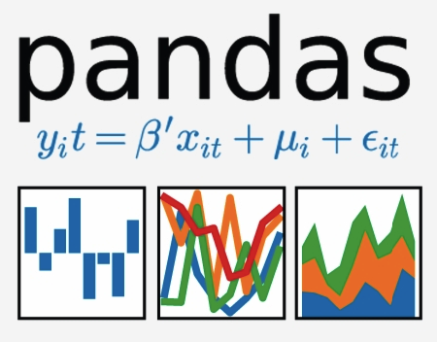




Python Libraries for Data Analysis
Pandas
SciPy
NumPy
Matplotlib
Scikit-learn

Slide 40
Prepare the Data

Slide 41
3 Types of Data
Numerical
Discrete: 10, 15, IQ, SAT
Continuous: .005, 3.1415, GPA
Categorical Gender, Nationality
Ordinal 1st, 2nd, star rating

Slide 42
Graduate School Application
GPA | TOEFL | LOR | Race | GRE | Admitted
3.89 | 108 | 5 | Other | 337 | No
3.22 | 118 | 4 | Black | 314 | Yes
3.74 | 110 | 4 | White | 323 | Yes
3.56 | 98 | 3.5 | White | 331 | No
3.91 | 103 | 3 | Hispanic | 319 | No
3.43 | 111 | 4.5 | Other | 324 | Yes

Slide 43
Graduate School Application
Features
GPA | TOEFL | LOR | Race | GRE | Admitted
3.89 | 108 | 5 | Other | 337 | No
3.22 | 118 | 4 | Black | 314 | Yes
3.74 | 110 | 4 | White | 323 | Yes
3.56 | 98 | 3.5 | White | 331 | No
3.91 | 103 | 3 | Hispanic | 319 | No
3.43 | 111 | 4.5 | Other | 324 | Yes

Slide 44
Graduate School Application
GPA | TOEFL | LOR | Race | GRE | Admitted
3.89 | 108 | 5 | Other | 337 | No
3.22 | 118 | 4 | Black | 314 | Yes
3.74 | 110 | 4 | White | 323 | Yes
3.56 | 98 | 3.5 | White | 331 | No
3.91 | 103 | 3 | Hispanic | 319 | No
3.43 | 111 | 4.5 | Other | 324 | Yes
Target

Slide 45
Graduate School Application
GPA | TOEFL | LOR | Race | GRE | Admitted
3.89 | 108 | 5 | Other | 337 | No
3.22 | 118 | 4 | Black | 314 | Yes
3.74 | 110 | 4 | White | 323 | Yes
3.56 | 98 | 3.5 | White | 331 | No
3.91 | 103 | 3 | Hispanic | 319 | No
3.43 | 111 | 4.5 | Other | 324 | Yes
Sample

Slide 46
Graduate School Application
GPA | TOEFL | LOR | Race | GRE | Admitted
3.89 | 108 | 5 | Other | 337 | No
3.22 | 118 | 4 | Black | 314 | Yes
3.74 | 110 | 4 | White | 323 | Yes
3.56 | 98 | 3.5 | White | 331 | No
3.91 | 103 | 3 | Hispanic | 319 | No
3.43 | 111 | 4.5 | Other | 324 | Yes

Slide 47
Transform the Data

Slide 48
Graduate School Application
GPA | TOEFL | LOR | Race | GRE | Admitted
3.89 | 108 | 5 | Other | 337 | No
3.22 | 118 | 4 | Black | 314 | Yes
3.74 | 110 | 4 | White | 323 | Yes
3.56 | 98 | 3.5 | White | 331 | No
3.91 | 103 | 3 | Hispanic | 319 | No
3.43 | 111 | 4.5 | Other | 324 | Yes

Slide 49
One-Hot Encoding

Slide 50
Graduate School Application
GPA | TOEFL | LOR | Race | GRE | Admitted
3.89 | 108 | 5 | Other | 337 | No
3.22 | 118 | 4 | Black | 314 | Yes
3.74 | 110 | 4 | White | 323 | Yes
3.56 | 98 | 3.5 | White | 331 | No
3.91 | 103 | 3 | Hispanic | 319 | No
3.43 | 111 | 4.5 | Other | 324 | Yes

Slide 51
Graduate School Application
GPA | TOEFL | LOR | Race-W | Race-B | Race-H | Race-O | GRE | Admitted
3.89 | 108 | 5 | 0 | 0 | 0 | 1 | 337 | No
3.22 | 118 | 4 | 0 | 1 | 0 | 0 | 314 | Yes
3.74 | 110 | 4 | 1 | 0 | 0 | 0 | 323 | Yes
3.56 | 98 | 3.5 | 1 | 0 | 0 | 0 | 331 | No
3.91 | 103 | 3 | 0 | 0 | 1 | 0 | 319 | No
3.43 | 111 | 4.5 | 0 | 0 | 0 | 1 | 324 | Yes

Slide 52
Graduate School Application
GPA | TOEFL | LOR | Race-W | Race-B | Race-H | Race-O | GRE | Admitted
3.89 | 108 | 5 | 0 | 0 | 0 | 1 | 337 | 0
3.22 | 118 | 4 | 0 | 1 | 0 | 0 | 314 | 1
3.74 | 110 | 4 | 1 | 0 | 0 | 0 | 323 | 1
3.56 | 98 | 3.5 | 1 | 0 | 0 | 0 | 331 | 0
3.91 | 103 | 3 | 0 | 0 | 1 | 0 | 319 | 0
3.43 | 111 | 4.5 | 0 | 0 | 0 | 1 | 324 | 1

Slide 53
DataFrame

Slide 54
Graduate School Application
GPA | TOEFL | LOR | Race-W | Race-B | Race-H | Race-O | GRE | Admitted
3.89 | 108 | 5 | 0 | 0 | 0 | 1 | 337 | 0
3.22 | 118 | 4 | 0 | 1 | 0 | 0 | 314 | 1
3.74 | 110 | 4 | 1 | 0 | 0 | 0 | 323 | 1
3.56 | 98 | 3.5 | 1 | 0 | 0 | 0 | 331 | 0
3.91 | 103 | 3 | 0 | 0 | 1 | 0 | 319 | 0
3.43 | 111 | 4.5 | 0 | 0 | 0 | 1 | 324 | 1

Slide 55
Graduate School Application
GPA | TOEFL | LOR | Race-W | Race-B | Race-H | Race-O | GRE | Admitted
3.89 | 108 | 5 | 0 | 0 | 0 | 1 | 337 | 0
3.22 | 118 | 4 | 0 | 1 | 0 | 0 | 314 | 1
3.74 | 110 | 4 | 1 | 0 | 0 | 0 | 323 | 1
3.56 | 98 | 3.5 | 1 | 0 | 0 | 0 | 331 | 0
3.91 | 103 | 3 | 0 | 0 | 1 | 0 | 319 | 0
3.43 | 111 | 4.5 | 0 | 0 | 0 | 1 | 324 | 1

Slide 56
Graduate School Application
GPA | TOEFL | LOR | Race-W | Race-B | Race-H | Race-O | GRE | Admitted
3.89 | 108 | 5 | 0 | 0 | 0 | 1 | 337 | 0
3.22 | 118 | 4 | 0 | 1 | 0 | 0 | 314 | 1
3.74 | 110 | 4 | 1 | 0 | 0 | 0 | 323 | 1
3.56 | 98 | 3.5 | 1 | 0 | 0 | 0 | 331 | 0
3.91 | 103 | 3 | 0 | 0 | 1 | 0 | 319 | 0
3.43 | 111 | 4.5 | 0 | 0 | 0 | 1 | 324 | 1
GPA | TOEFL | LOR | Race-W | Race-B | Race-H | Race-O | GRE | Admitted
3.89 | 108 | 5 | 0 | 0 | 0 | 1 | 337 | 0
3.22 | 118 | 4 | 0 | 1 | 0 | 0 | 314 | 1
3.74 | 110 | 4 | 1 | 0 | 0 | 0 | 323 | 1
3.56 | 98 | 3.5 | 1 | 0 | 0 | 0 | 331 | 0
3.91 | 103 | 3 | 0 | 0 | 1 | 0 | 319 | 0
3.43 | 111 | 4.5 | 0 | 0 | 0 | 1 | 324 | 1
X =
y =
Features
Target

Slide 57
Pandas
GPA | TOEFL | LOR | GRE
3.89 | 108 | 5 | 337
3.22 | 118 | 4 | 314
3.74 | 110 | 4 | 323
3.56 | 98 | 3.5 | 331
3.91 | 103 | 3 | 319
3.43 | 111 | 4.5 | 324
DataFrame

Slide 58
NumPy
GPA | TOEFL | LOR | GRE
3.89 | 108 | 5 | 337
3.22 | 118 | 4 | 314
3.74 | 110 | 4 | 323
3.56 | 98 | 3.5 | 331
3.91 | 103 | 3 | 319
3.43 | 111 | 4.5 | 324
Matrix
(2d)

Slide 59





Slide 60
GPA | TOEFL | LOR | GRE
3.89 | 108 | 5 | 337
3.22 | 118 | 4 | 314
3.74 | 110 | 4 | 323
3.56 | 98 | 3.5 | 331
3.91 | 103 | 3 | 319
3.43 | 111 | 4.5 | 324

Slide 61
Mean
GPA | TOEFL | LOR | GRE
3.89 | 108 | 5 | 337
3.22 | 118 | 4 | 314
3.74 | 110 | 4 | 323
3.56 | 98 | 3.5 | 331
3.91 | 103 | 3 | 319
3.43 | 111 | 4.5 | 324

Slide 62
Axis = 0
GPA | TOEFL | LOR | GRE
3.89 | 108 | 5 | 337
3.22 | 118 | 4 | 314
3.74 | 110 | 4 | 323
3.56 | 98 | 3.5 | 331
3.91 | 103 | 3 | 319
3.43 | 111 | 4.5 | 324

Slide 63
Axis = 0
GPA | TOEFL | LOR | GRE
3.89 | 108 | 5 | 337
3.22 | 118 | 4 | 314
3.74 | 110 | 4 | 323
3.56 | 98 | 3.5 | 331
3.91 | 103 | 3 | 319
3.43 | 111 | 4.5 | 324
3.63
108
3.17
325

Slide 64
Axis = 1
GPA | TOEFL | LOR | GRE
3.89 | 108 | 5 | 337
3.22 | 118 | 4 | 314
3.74 | 110 | 4 | 323
3.56 | 98 | 3.5 | 331
3.91 | 103 | 3 | 319
3.43 | 111 | 4.5 | 324

Slide 65
Axis = 1
GPA | TOEFL | LOR | GRE
3.89 | 108 | 5 | 337
3.22 | 118 | 4 | 314
3.74 | 110 | 4 | 323
3.56 | 98 | 3.5 | 331
3.91 | 103 | 3 | 319
3.43 | 111 | 4.5 | 324
113.47
115.80
110.19
109.02
107.23
110.73

